Slide 1

Measuring the Exposure to Air Pollution for Pedestrians in Boston Metropolitan Area and its Relation to Walkability
Tufts University | UEP238 | Final Project
Presented By: Patrali Ghosh and Vishwesh Srinivasan

Slide 2
Table of Contents
01
02
03
04
05
06
Introduction
Research Questions
Data
Visualizations
Statistical Analysis
Conclusions

Slide 3
Introduction
Air pollution is an environmental issue globally, leading to long-term adverse effects like climate change due to increased CO₂ and other greenhouse gases.
Different modes of transportation lead to varying levels of pollution exposure.
We focus on pedestrian’s exposure to air pollution in the Boston Metropolitan Area.
The general hypothesis states that areas with a high walkability index have higher air pollution levels.

Slide 4
Research Questions
What is the exposure to air pollution, specifically NOx, for pedestrians in the Greater Boston Region?
What is the walkability for the areas in the Greater Boston Region?
Is there any correlation between the NOx concentrations and the walkability for the areas in Greater Boston Region?
Does this correlation determined vary spatially?

Slide 5
Data
Sources
Census 2010 Census Block Groups (CBGs) boundary shapefile provided by MassGIS
National Walkability Index dataset, part of Smart Location Mapping provided by United States EPA
NOx Concentration in ppb downloaded for Greater Boston Area (10m x 10m grids) from the C-LINE tool ⁽¹⁾
Preparation
All the 10m x 10 m grid shapefiles downloaded from C-LINE tool was combined by removing duplicate CBGs and combining partial CBGs.
The above dataset was combined with the Census 2010 CBGs boundary shapefile and the National Walkability Index dataset based on the GOEID10 column (unique identifier used to identify a census block group).
The geometry of the CBGs is retained from the Census 2010 CBGs boundary shapefile for visualization purposes.
(1) This dataset was downloaded and provided by Hongkun Huang (Hongkun.Huang@tufts.edu)

Slide 6

Visualizations

Slide 7
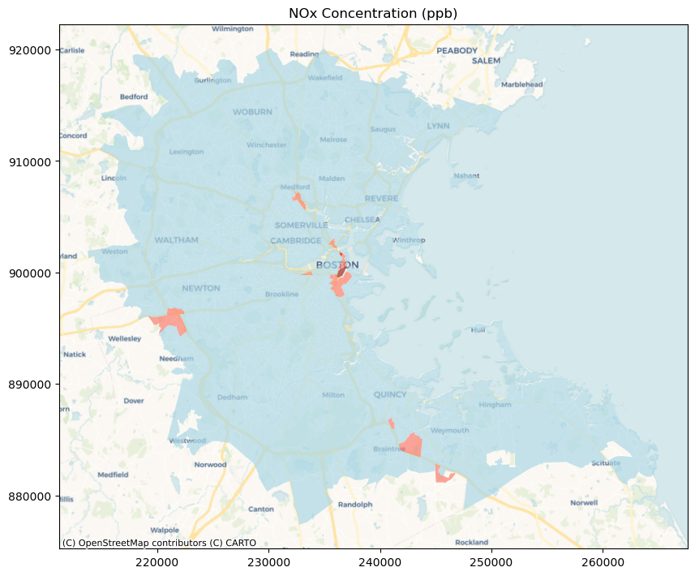
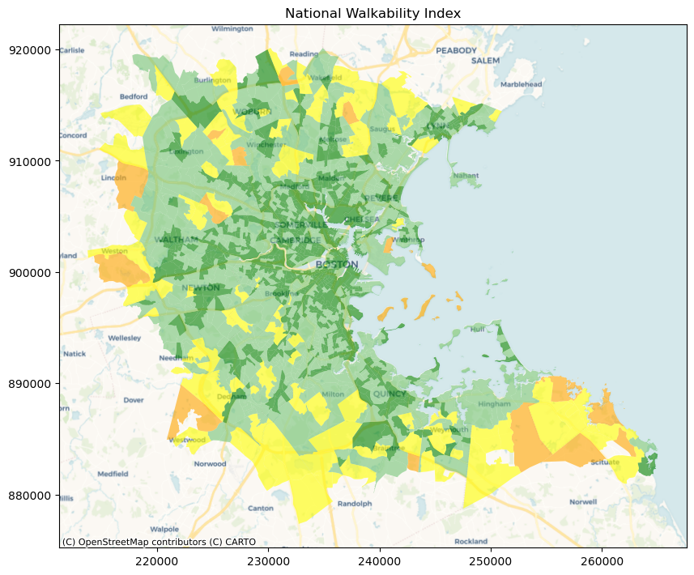
Greater Boston Region
Legend for Pollution
 | 0 - 18.75
 | 18.75 - 37.5
 | 37.5 - 56.25
 | 56.25 - 75
Legend for Walkability
 | 0 - 5.75
 | 5.75 - 10.5
 | 10.5 - 15.25
 | 15.25 - 20

Slide 8
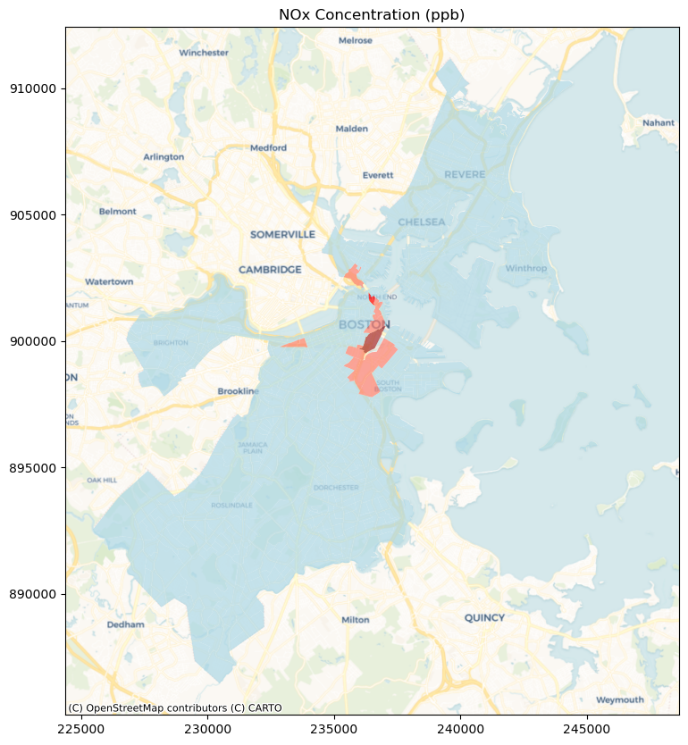
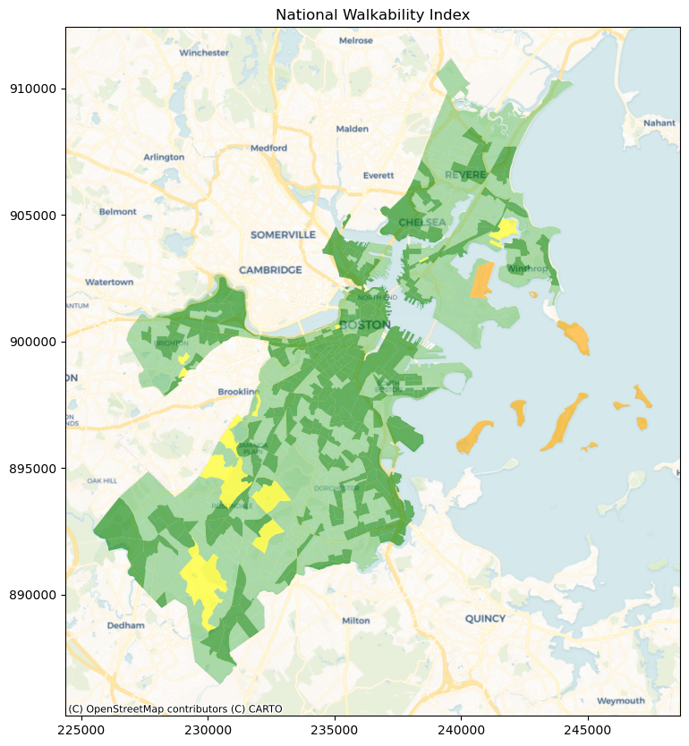
Boston City
Legend for Pollution
 | 0 - 18.75
 | 18.75 - 37.5
 | 37.5 - 56.25
 | 56.25 - 75
Legend for Walkability
 | 0 - 5.75
 | 5.75 - 10.5
 | 10.5 - 15.25
 | 15.25 - 20

Slide 9

Statistical Analysis

Slide 10
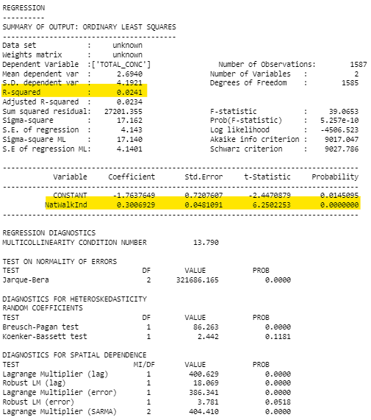
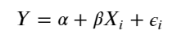
Spatial Regression - Baseline
Weights Matrix:
Calculated based on the Centroids of the Census Block Groups
Dependent Variable:
NOx Concentration (ppb)
Independent Variable:
National Walkability Index

Slide 11
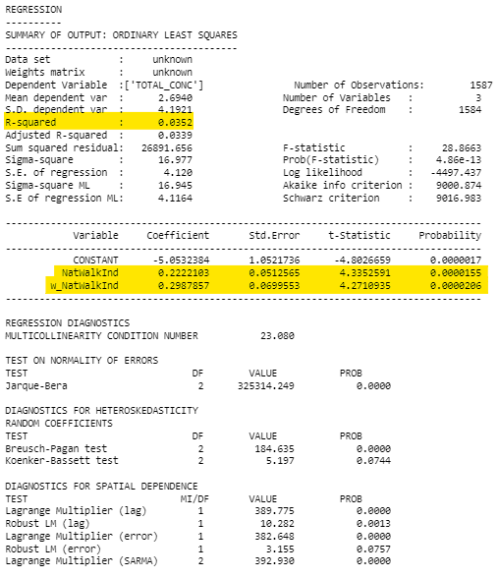
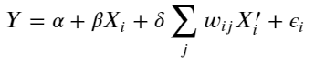
Spatial Regression - Spatially lagged exogenous regressors
Weights Matrix:
Calculated based on the Centroids of the Census Block Groups
Dependent Variable:
NOx Concentration (ppb)
Independent Variable:
National Walkability Index
National Walkability Index as spatially lagged variable

Slide 12
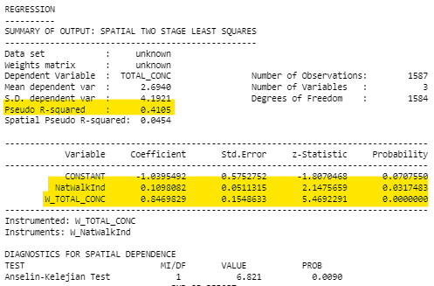
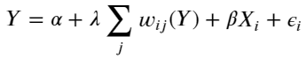
Spatial Regression - Spatially lagged endogenous regressors
Weights Matrix:
Calculated based on the Centroids of the Census Block Groups
Dependent Variable:
NOx Concentration (ppb)
Independent Variable:
National Walkability Index

Slide 13
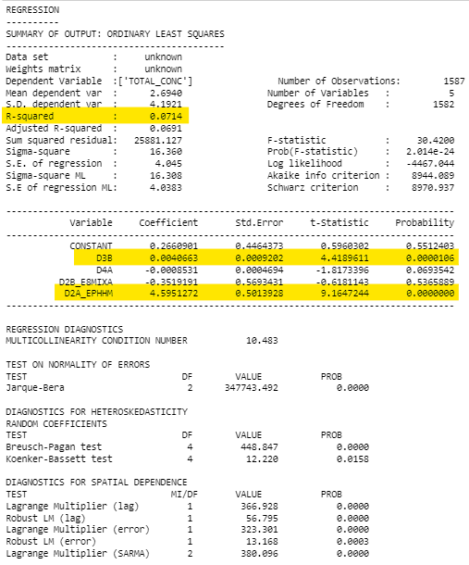
Spatial Regression - Baseline
Weights Matrix:
Calculated based on the Centroids of the Census Block Groups
Dependent Variable:
NOx Concentration (ppb)
Independent Variable:
Intersection Density (D3B)
Proximity to transit stops (D4A)
Employment Mix (D2B_E8MIXA)
Employment and household mix (D2A_EPHHM)

Slide 14
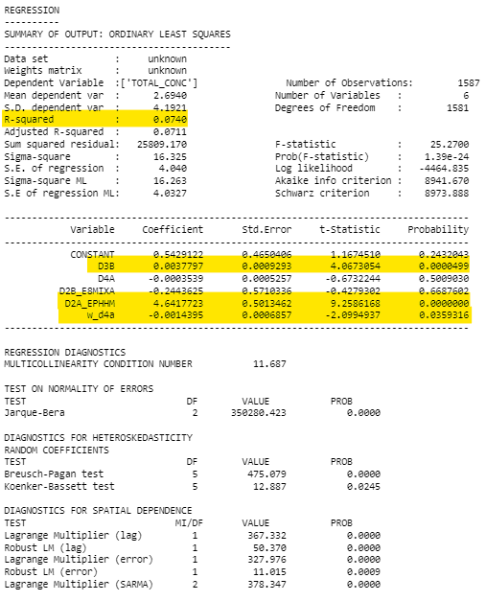
Spatial Regression - Spatially lagged exogenous regressors
Weights Matrix:
Calculated based on the Centroids of the Census Block Groups
Dependent Variable:
NOx Concentration (ppb)
Independent Variable:
Intersection Density (D3B)
Proximity to transit stops (D4A)
Employment Mix (D2B_E8MIXA)
Employment and household mix (D2A_EPHHM)
D4A as spatially lagged variable

Slide 15
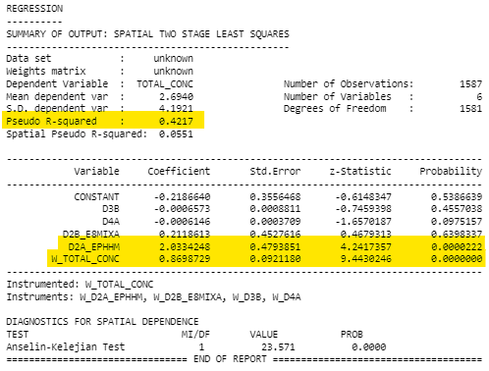
Spatial Regression - Spatially lagged endogenous regressors
Weights Matrix:
Calculated based on the Centroids of the Census Block Groups
Dependent Variable:
NOx Concentration (ppb)
Independent Variable:
Intersection Density (D3B)
Proximity to transit stops (D4A)
Employment Mix (D2B_E8MIXA)
Employment and household mix (D2A_EPHHM)

Slide 16
Conclusions from Visualizations
From the slides we can see, most of the higher pollution areas are focused in Boston.
It follows the general pattern of high walkability having high pollution exposure. The suburbs on the edge of the Greater Boston Area, has a low walkability score and low pollution exposure.
In the slide with focus on Boston, we can see that certain areas marked for having great walkability has a low pollution score, which does not follow the general pattern of having a high walkability score linked with high pollution exposure.

Slide 17
Conclusions from Statistical Analysis
We observe that the National Walkability Index is statistically significant and has a positive coefficient in relation to the dependent variable (NOx concentration)
The analysis also indicates the spatial dependence between the NOx concentration and the National Walkability Index
On further analysis of the variables which is used to determine the National Walkability Index, the following variables: Intersection Density and Employment and Household Mix are found to be statistically significant. Both the variables have a positive coefficient.
The analysis also indicates the spatial dependence between the NOx concentration and the independent variables: Intersection Density and Employment and Household Mix.

Slide 18
Policy Implications & Future Research
Policy Implications
Encouraging the use of public transportation instead of personal vehicles
Increasing green spaces in places with high walkability and air pollution
Promoting clean transportation like electric vehicles and bicycles
Future Research
Relationship between National Walkability Index and other pollutants like particulate matter, ozone, and carbon monoxide can be explored.
The scale of the project can be expanded to the explore the relationships between the concentrations of different pollutants and the other mode of transportations.

Slide 19
References
MassGIS Data: 2010 U.S. Census | Mass.gov
Smart Location Mapping | US EPA
Community-LINE Source Model (C-LINE) to estimate roadway emissions | US EPA

Slide 20
Q&A

Slide 21
Thank You!

